Slide 1

6th Grade Social Studies
Unit 3, Lesson 6
Theories of Migration

Slide 2
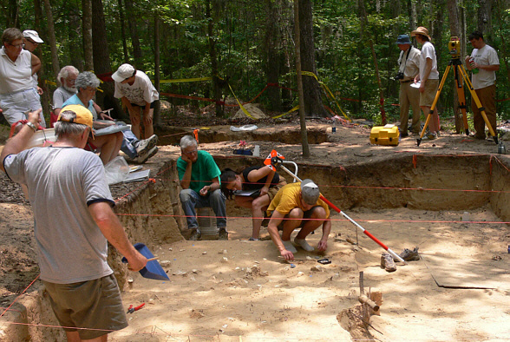
Notes:
The Topper Site. 24 November 2012. http://allendale-expedition.net/

Slide 3
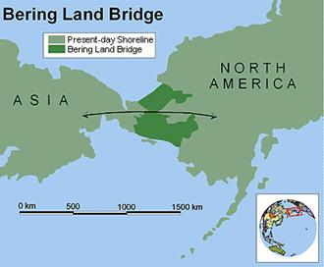
The Land Bridge Theory
By the early 1900s, most historians had accepted a theory that people first migrated to the Americas from Asia across a “land bridge” during one of Earth’s ice ages.
During this time large amounts of water had frozen into glaciers so the oceans became shallower. This caused a bridge of dry land about 1000 miles wide to appear between the continents of Asia and North America.
Notes:
Bering Land Bridge. 16 November 2012. http://chinese-unicorn.com/wp-content/uploads/2012/08/image063.jpg

Slide 4
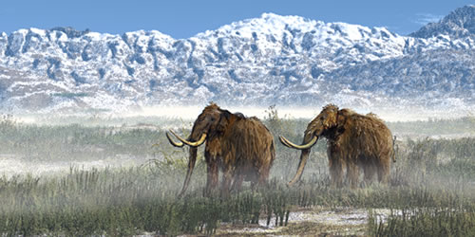
The Land Bridge Theory
Some historians believe the first Americans crossed this land bridge about 12,000 – 13,000 years ago.
Historians thought that these early people were probably following large animals such as mammoths, which were their main source of food.
Notes:
Wooly Mammoths. 24 November 2012. http://www.sfu.museum/journey/an-en/secondaire1er-middle/animaux-animals/mammouth-mammoth

Slide 5
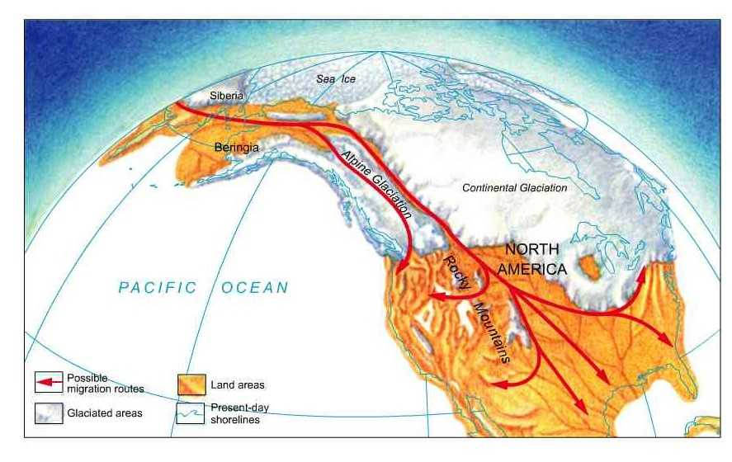
The Land Bridge Theory
Slowly these hunters made their way farther and farther into the Americas.
Some historians believe these people became the first Americans.
Notes:
Possible Routes Map. 24 November 2012. http://drarchaeology.com/culthist/origins.htm

Slide 6
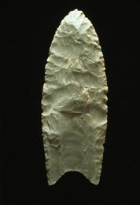
Evidence for the Land Bridge Theory
In the 1930s spear points were found in in New Mexico. Some historians believed that these spear points were used for hunting mammoths by early hunters whose ancestors had crossed the land bridge.
The first of these artifacts were found near Clovis, New Mexico so these early people became known as the “Clovis” people.
In the 1950s the same type of spear points were found in Arizona.
Scientific testing dated these “Clovis points” as being around 11,000 years old.
This led many historians to believe that the land bridge theory was correct and people had been in the Americas for about 12,000 years.
Notes:
Clovis Point. 24 November 2012. http://en.wikipedia.org/wiki/Clovis_point

Slide 7

ACTIVITY
Investigating New Evidence
Notes:
The Topper Site. 24 November 2012. http://allendale-expedition.net/

Slide 8
Notes:
The Topper Site. 24 November 2012. http://allendale-expedition.net/

Slide 9
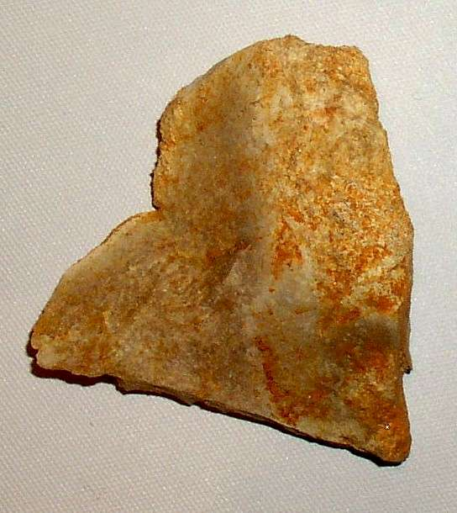
The Topper Site in South Carolina
In 2004, Dr. Albert Goodyear and his team uncovered flakes of stone that looked like those made by humans in southwestern South Carolina.
Later more stone flakes and charred plants that may have been from a hearth were found.
Scientific tests dated the objects at this site as being 50,000 years old. This would make them at least 25,000 years older than any other known human site in the Americas.
Notes:
Artifact from the Topper Site. 24 November 2012. http://www.daysknob.com/Topper_A.htm

Slide 10
The Topper Site in South Carolina
This could mean that people may have crossed the land bridge into the Americas much earlier.
It might also mean that people used a different way to enter the Americas than the land bridge.
Historians and archaeologists are continuing to examine the artifacts found at the site.
People who disagree with the findings say the artifacts are natural, not made by humans.

Slide 11
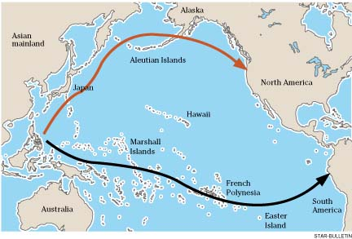
Pacific Coastal Theory
People with boats may have moved along the Pacific coast into Alaska and Canada and then south down the coastline all the way to Peru and Chile.
Notes:
Coastal Theory Map. 24 November 2012. http://ows.edb.utexas.edu/site/hight-kreitman/coastal-route-theory

Slide 12
Pacific Coastal Theory
Possible Evidence: Research in Australia and Japan has shown that boats were in use as far back as 25,000 to 40,000 years ago.
Problems Finding Evidence: The oceans are higher now and sites where early humans would have lived along the coasts are under water.

Slide 13
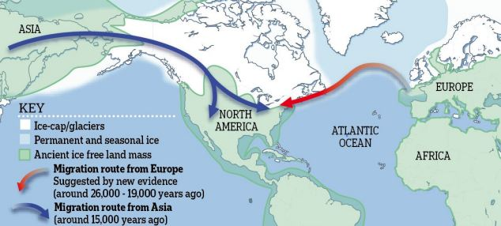
Atlantic Coastal Theory
People with boats may have sailed from Europe to reach the Americas or across the Atlantic.
Notes:
Atlantic Coastal Theory Map. 24 November 2012. http://www.dailymail.co.uk/sciencetech/article-2107418/Could-tools-belonging-Stone-Age-hunters-U-S-east-coast-finally-answer-really-discovered-America.html

Slide 14
Atlantic Coastal Theory
Possible Evidence: Similar spear points to those found at sites in the Americas have been found in an area of coastal Europe. They were made by people known as Solutreans. These people may have traveled by boat to the Americas and settled along the east coast.
Problems Finding Evidence: Other than the spear points, no other evidence has been found yet.
Notes:
Coastal Theory Map. 24 November 2012. http://ows.edb.utexas.edu/site/hight-kreitman/coastal-route-theory

Slide 15
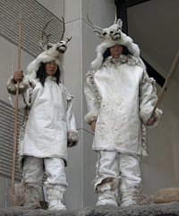
What do historians agree on??
These original settlers were able to adapt or change to fit the environment.
  They were able to survive in subfreezing temperatures.
  They were able to build fires, build insulated housing, and make warm clothes.
Without wheeled vehicles or riding animals, they were able to spread across South and North America.
Notes:
Michigan’s First People. 24 November 2012. http://www.hal.state.mi.us/mhc/firstpeople/firstpeople.html

Slide 16
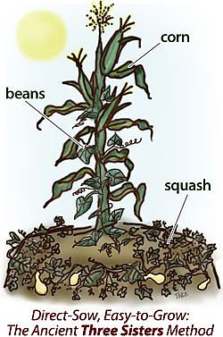
What do historians agree on??
As conditions changed, these early Americans began to hunt smaller animals and gather food like berries and food plants. They developed nets and hooks for fishing.
Eventually they began to farm. This allowed them to live in more permanent settlements.
Notes:
Native American Crops. 24 November 2012. http://grandrapidsnaturalliving.com/adventures-in-gardening/

Slide 17
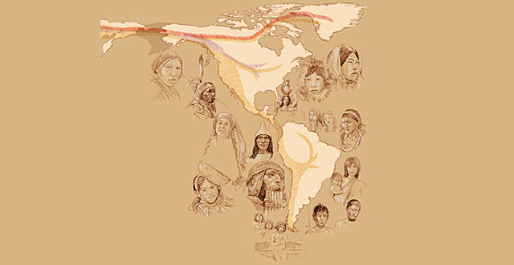
What do historians agree on??
As they spread across the Americas, these people developed hundreds of separate cultures with different languages, types of shelters, art forms, and traditions. We have come to know these people as Native Americans.
Notes:
Native American Cultures. 24 November 2012. http://www.sci-news.com/images/2012/07/image_463.jpg

Slide 18
Property of Oakland Schools
Author: Carol Egbo
Editors: Amy Bloom and Kimberly Hase Galek

