Slide 1
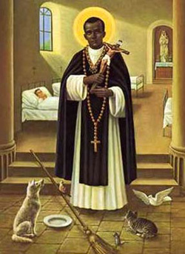
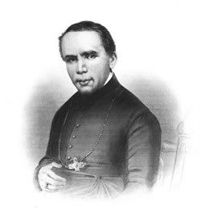
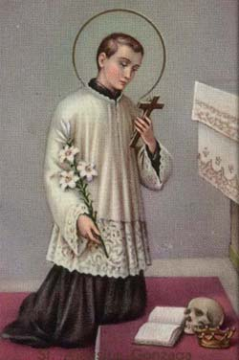
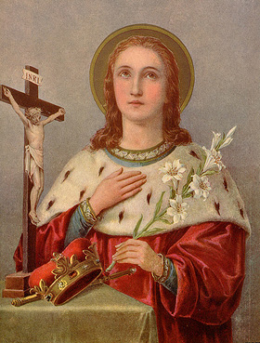
A. St. Martin de Porres
B. St. John Neuman
C. St. Casimir
D. St. Aloysius Gonzaga

Slide 2
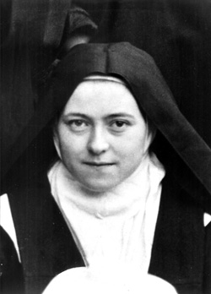
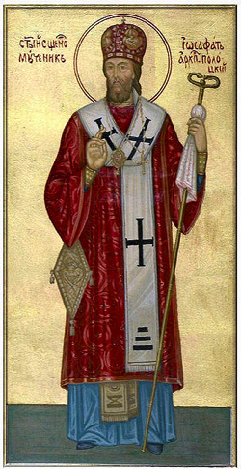
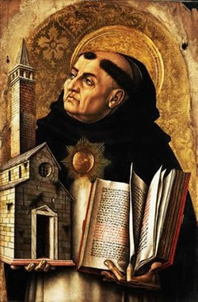
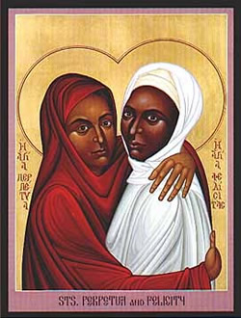
A. St. Therese of the Child Jesus
(St. Therese of Lisieux)
B. St. Josaphat
C. St. Thomas Aquinas
D. St. Perpetua

Slide 3
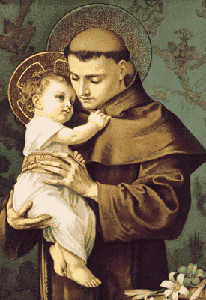
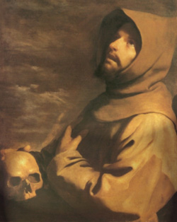
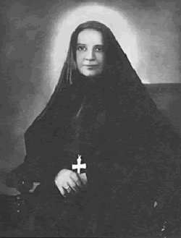
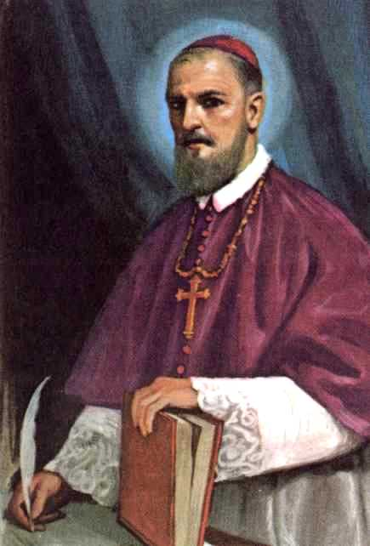
B. St. Francis of Assisi
St. Anthony of Padua
C. St. Francis Xavier Cabrini
D. St. Francis de Sales

Slide 4
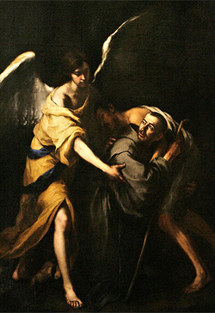
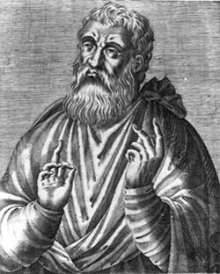
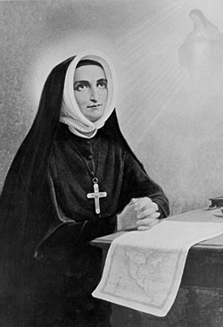
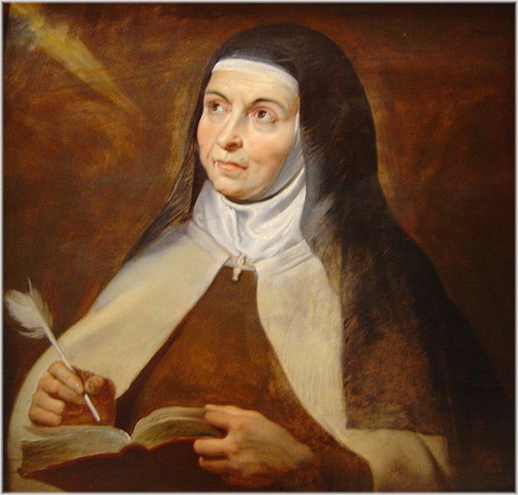
A. St. John of God
B. St. Justin
D. St. Rose Philippine Duchesne
C. St. Teresa of Jesus

Slide 5
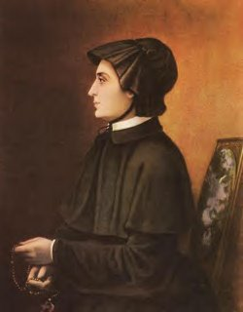
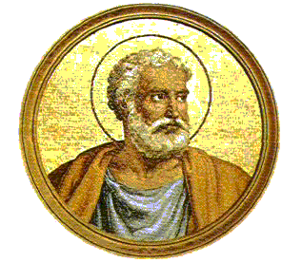
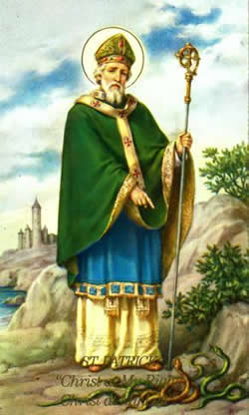
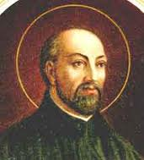
A. St. Elizabeth Ann Seton
B. St. Peter
C. St. Patrick
D. St. John de BreBeuf

Slide 6
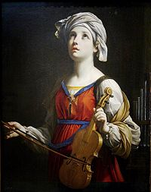
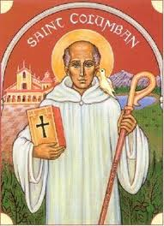
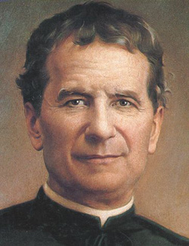
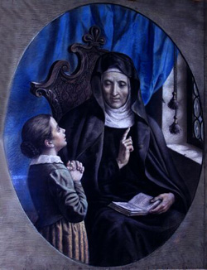
A. St. Cecilia
B. St. Columban
C. St. John Bosco
D. St. Angela de Merici

Slide 7
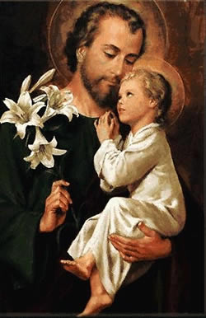
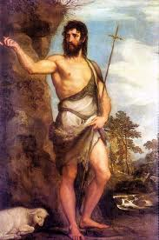
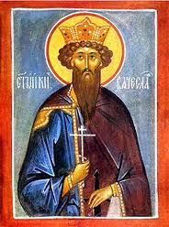
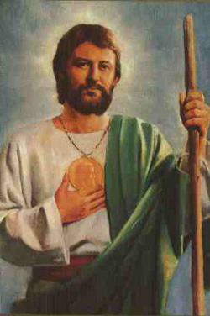
A. St. Joseph
B. St. John the Baptist
C. St. Jude
D. St. Wenceslaus

Slide 8
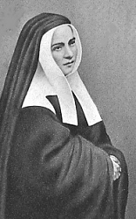
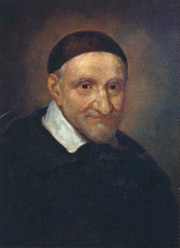
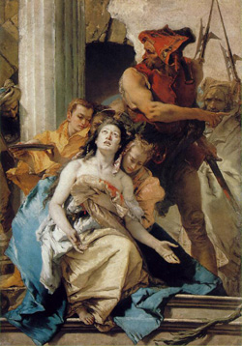
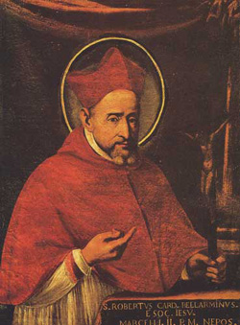
A. St. Bernadette
B. St. Vincent de Paul
C. St. Agatha
D. St. Robert Bellarmine

Slide 9
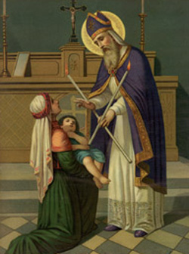
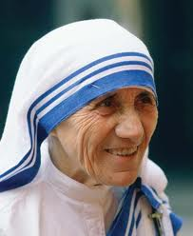
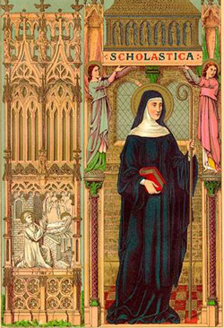
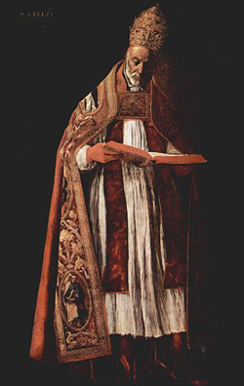
A. St. Blaise
B. Blessed Mother Teresa of Calcutta
D. St. Gregory the Great
C. St. Scholastica

Slide 10
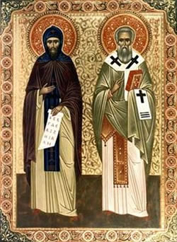
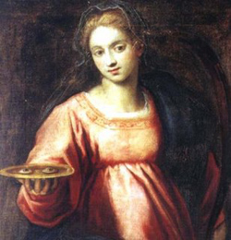
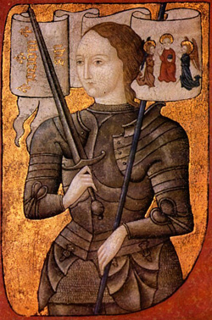
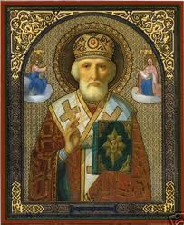
A. St. Cyril and St. Methodius
B. St. Lucy
C. St. Joan of Arc
D. St Nicholas

Slide 11
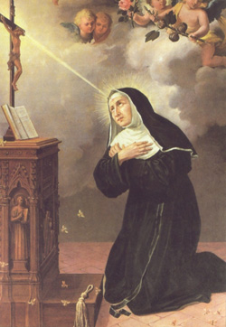
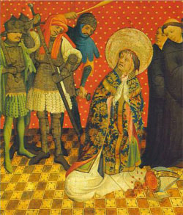
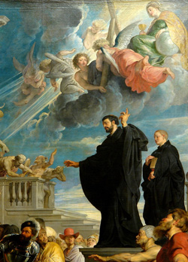
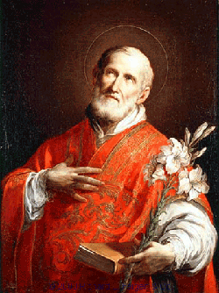
B. St. Thomas Becket
A. St. Rita of Cascia
D. St. Francis Xavier
C. St. Philip Neri

Slide 12
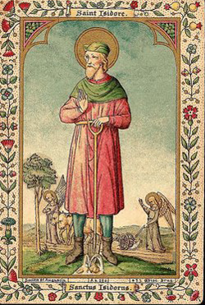
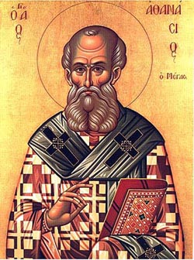
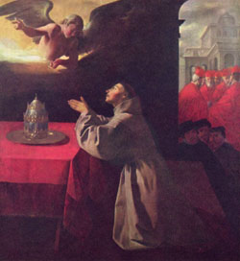
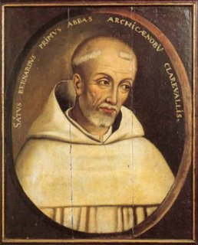
A. St. Isidore the Farmer
B. St. Athanasius
C. St. Bonaventure
D. St. Bernard of Clairvaux

Slide 13
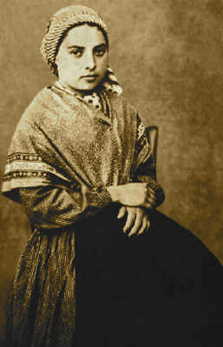
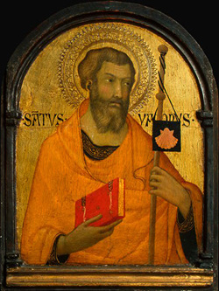


A. St. Bernadette Soubirous
B. St. James the Greater
C. St. Monica
D. St. Mark

Slide 14




A. St. Benedict of Nursia
B. St. Clare of Assisi
C. St. George
D. St. Anne

Slide 15





A. St. Dominic
B. St. John the Baptist De La Salle
C. St. Mary Magdalene
D. St. Rose of Lima
E. St. Catherine of Siena

