Slide 1
Our Lenten Prayer Process
Mrs. Otte Fifth Grade
Taken from
The Four Signs of a Dynamic Catholic
By Matthew Kelly

Slide 2
Gratitude
Begin by thanking God in a personal dialogue for whatever you are most grateful for today.

Slide 3
Awareness
Revisit the times in the past twenty-four hours when you were and were not the-best-version-of-yourself. Talk to God about these situations and what you learned from them.

Slide 4
Significant Moments
Identify something you experienced today and explore what God might be trying to say to you through the event (or person).

Slide 5
Peace
Ask God to forgive you for any wrong you have committed (against yourself, another person, or him) and to fill you with a deep and abiding peace.

Slide 6
Freedom
Speak with God about how he is inviting you to change your life, so that you can experience the freedom to be the-best-version-of-yourself.

Slide 7
Others
Lift up to God anyone you feel called to pray for today, asking God to bless and guide them.

Slide 8
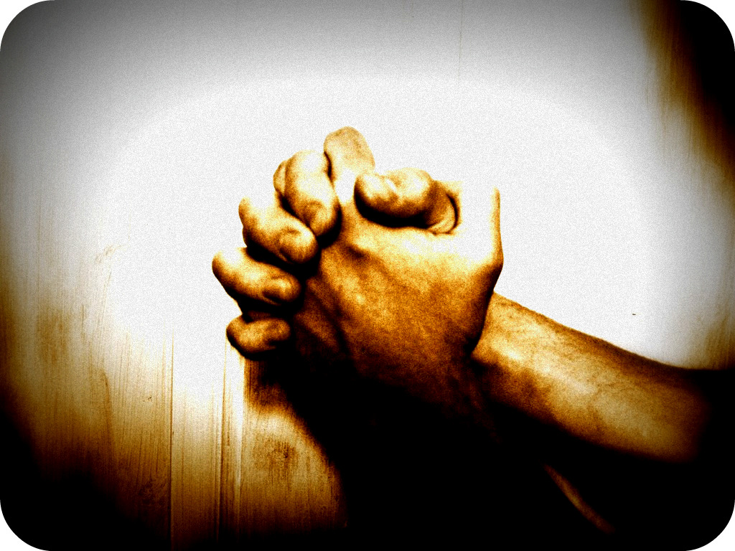
Finish by saying the Our Father

