Slide 1

6th Grade Social Studies
Unit 3, Lesson 5:
Migration

Slide 2
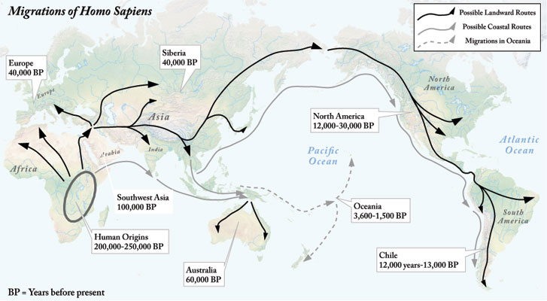
Notes:
Migrations of Homo Sapiens. World History for Us All. San Diego State University. 20 November 2012 <http://worldhistoryforusall.sdsu.edu/eras/era2.php>.

Slide 3
Food
Notes:
Migrations of Homo Sapiens. World History for Us All. San Diego State University. 20 November 2012 <http://worldhistoryforusall.sdsu.edu/eras/era2.php>.

Slide 4
Food
Space
Notes:
Migrations of Homo Sapiens. World History for Us All. San Diego State University. 20 November 2012 <http://worldhistoryforusall.sdsu.edu/eras/era2.php>.

Slide 5
Food
Space
Climate
Notes:
Migrations of Homo Sapiens. World History for Us All. San Diego State University. 20 November 2012 <http://worldhistoryforusall.sdsu.edu/eras/era2.php>.

Slide 6
Notes:
Migrations of Homo Sapiens. World History for Us All. San Diego State University. 20 November 2012 <http://worldhistoryforusall.sdsu.edu/eras/era2.php>.

Slide 7
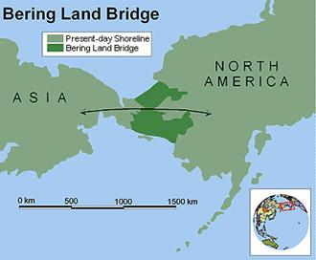
Notes:
Bering Land Bridge. Chinese Unicorn. 20 November 2012 <http://chinese-unicorn.com/wp-content/uploads/2012/08/image063.jpg>.

Slide 8
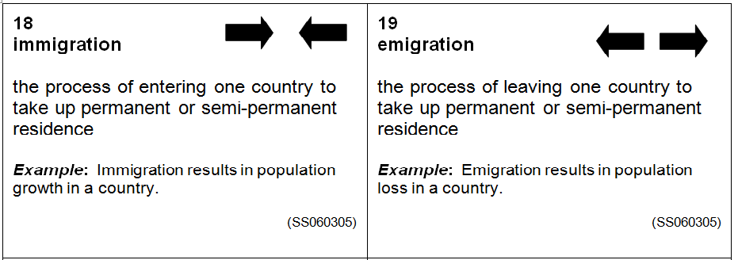

Slide 9
Net Migration

Slide 10
Net Migration
The number of
immigrants per 1000

Slide 11
Net Migration
The number of
immigrants per 1000
minus

Slide 12
Net Migration
The number of
immigrants per 1000
minus
The number of
Emigrants per 1000

Slide 13
Activity
Analyzing Migration Data

Slide 14
Property of Oakland Schools
Author: Carol Egbo
Editors: Amy Bloom and Kimberly Hase Galek

